Slide 1

WELCOME
COHORT 5
7th Sept – 3rd Dec 2026
Suite 6-6-7, Level 6, Menara MAA

Slide 2



Languages for Building Web Application
Build a web page structure
Add stylings to web page
Add dynamic behavior/interactivity
to web page
Notes:
How it works:
When you visit a website, your web browser (like Chrome, Firefox, Safari, Edge) downloads the HTML file for that page. The browser then reads the HTML code and renders it visually on your screen, displaying the text, images, and other elements according to the instructions given by the HTML tags.
It's important to note that HTML is primarily for structure and content. For styling (colors, fonts, layout) you use CSS (Cascading Style Sheets), and for interactivity (animations, dynamic content) you use JavaScript. Together, HTML, CSS, and JavaScript form the core technologies of the World Wide Web.

Slide 3
Introduction to HTML
What is a HTML File?
  HTML stands for Hyper Text Markup Language
  A HTML file is a text file containing small markup tags
  The markup tags tell the Web browser how to display the page
  A HTML file must have an htm or html file extension
  A HTML file can be created using a simple text editor and etc.

Slide 4
HTML Elements
  HTML tags are used to mark-up HTML elements
  HTML tags are surrounded by the two characters < and >
  The surrounding characters are called angle brackets
  HTML tags normally come in pairs like <b> and </b>
  The first tag in a pair is the start tag, the second tag is the end tag
  The text between the start and end tags is the element content
  HTML tags are not case sensitive, <b> means the same as <B>

Slide 5
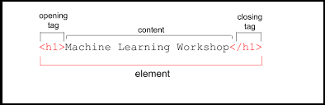
HTML Elements
Examples of HTML elements:
<b>This text is bold</b>
<body> This is my first homepage. <b>This text is bold</b>
</body>

Slide 6
Basic HTML Tags
<body> tag - Contains all visible content
Viewport meta tag - Makes your page mobile-friendly
Headings (<h1>, <h2>, <h3>, (<h4>, <h5>, <h6>) - Different sizes of titles
Paragraphs (<p>) - For text content
Unordered list (<ul> and <li>) - For bullet points
Link (<a>) - Links to external websites
Image (<img>) - A placeholder image

Slide 7
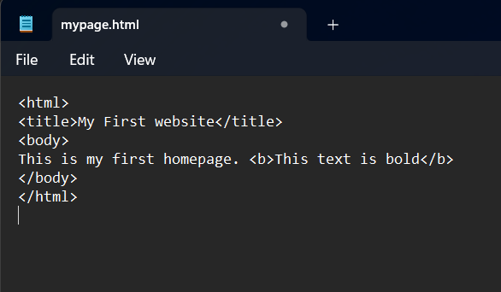
HTML using text editor (Hands On)
Open Notepad file and type in the following text:
Save the file as “mypage.html”

Slide 8
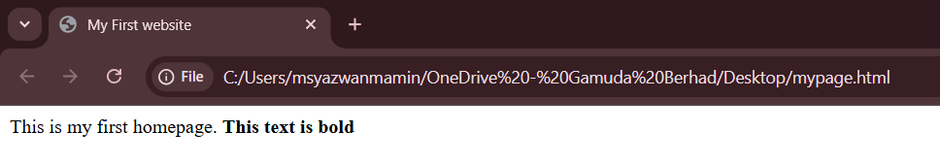
HTML using text editor (Hands On)
Start Internet browser, select “Open File” in the file menu.
Select "Browse" (or "Choose File") and locate the "mypage.html”
Select it and click "Open"

Slide 9
HTML Attributes
  HTML tags can have attributes. Attributes provide additional information to an HTML element.
  Attributes always come in name/value pairs like this: name="value".
  Attributes are always specified in the start tag of an HTML element.

Slide 10
HTML Attributes (Hands On)
Attributes Example 1:Center aligned heading
  <h1> defines the start of a heading.
  <h1 align="center"> has additional information about the alignment.
  try this program using notepad
  (can continue in previous “mypage.html” file) :
    <html>
    <body>
    <h1 align="center">This is heading 1</h1>
    </body>
    </html>

Slide 11
HTML Attributes (Hands On)
Attributes Example 2:Background color
  <body> defines the body of an HTML document.
  <body bgcolor="yellow"> has additional information about the background color.
  try this program using notepad
  (can continue in previous “mypage.html” file) :
<html>
<body bgcolor="yellow">
<h2>Look: Colored Background!</h2>
</body>
</html>

Slide 12
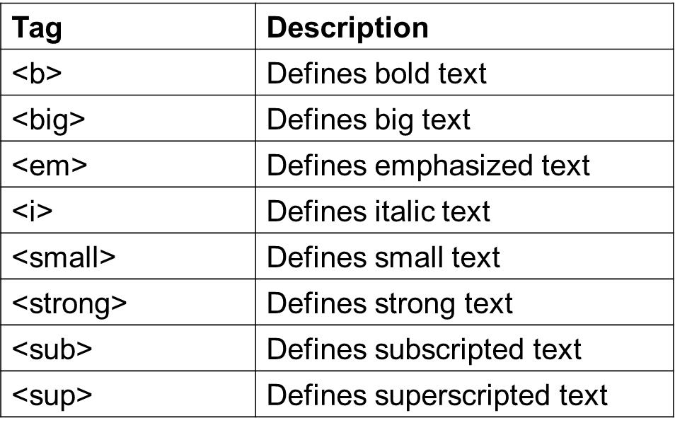
HTML Text Formatting
HTML defines a lot of elements for formatting output, like bold or italic text.

Slide 13
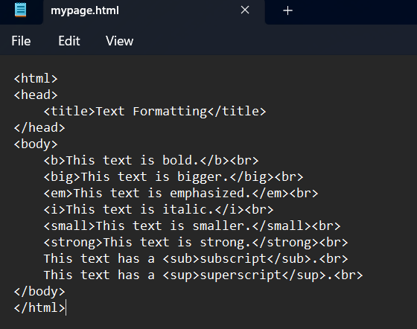
HTML Text Formatting (Hands On)
  try this program for
  formatting using notepad.
  (can continue in previous “mypage.html” file) :

Slide 14
HTML Character Entities
  Some characters have a special meaning in HTML, like the less than sign (<) =start of an HTML tag.
  If we want the browser to actually display these characters we must insert character entities in the HTML source.
  A character entity has three parts:
    an ampersand (&),
    an entity name or a # and an entity number,
    a semicolon (;)
  To display a less than sign in an HTML document we must write: &lt; or &#60;
  the entities are case sensitive.

Slide 15
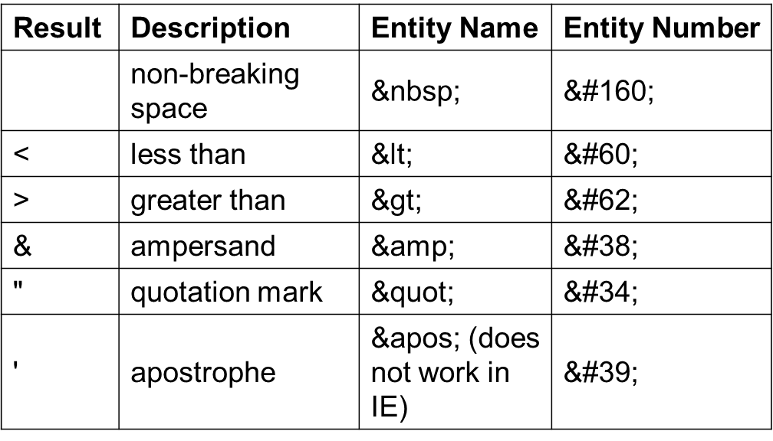
HTML Character Entities
  The Most Common Character Entities:
Notes:
What about font color?

Slide 16
HTML Character Entities
  The Most Common Character Entities:
Result | Description | Entity Name | Entity Number
¢ | cent | &cent; | &#162;
£ | pound | &pound; | &#163;
¥ | yen | &yen; | &#165;
€ | euro | &euro; | &#8364;
§ | section | &sect; | &#167;
© | copyright | &copy; | &#169;
® | registered trademark | &reg; | &#174;
× | multiplication | &times; | &#215;
÷ | division | &divide; | &#247;
Notes:
What about font color?

Slide 17
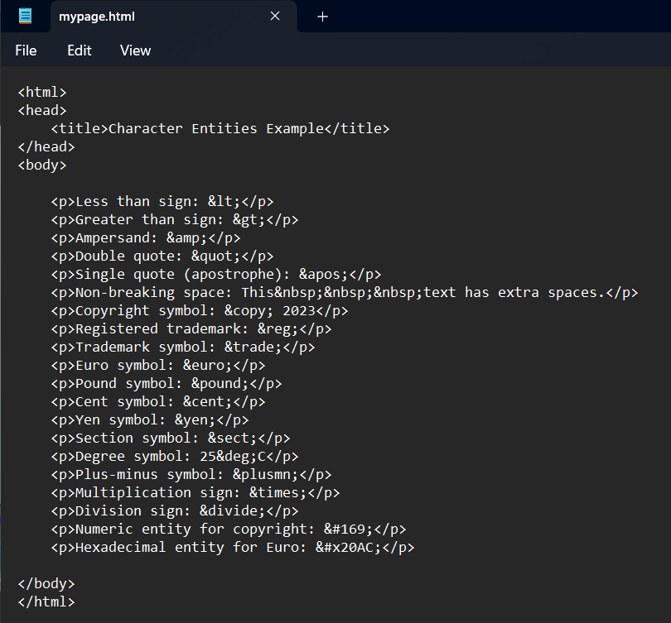
HTML Character Entities (Hands On)
Notes:
What about font color?

Slide 18
HTML Tables
Tables
  Tables are defined with the <table> tag.
  A table is divided into rows (with the <tr> tag), and each row is divided into data cells (with the <td> tag).
  A data cell can contain text, images, lists, paragraphs, forms, horizontal rules, tables, etc

Slide 19
HTML Tables
Example 1:
Output:
<html>
<body>
<table border="1">
<tr> <td>row 1, cell 1</td>
<td>row 1, cell 2</td>
</tr>
<tr>
<td>row 2, cell 1</td>
<td>row 2, cell 2</td>
</tr>
</table>
</body>
</html>
row 1, cell 1 | row 1, cell 2
row 2, cell 1 | row 2, cell 2

Slide 20
HTML Tables
Tables and the Border Attribute
  To display or hide a table borders, you will have to use the border attribute:
Table with border
Table without border
<table border="1">
<tr>
<td>Row 1, cell 1</td>
<td>Row 1, cell 2</td>
</tr>
</table>
<table border=“0">
<tr>
<td>Row 1, cell 1</td>
<td>Row 1, cell 2</td>
</tr>
</table>

Slide 21
HTML Tables
Tables and the Border Attribute
  Use the border attribute inside the opening <table tag to control the visibility and thickness of the table's grid lines. <table border=“1”> or <table border=“0”>
  A value of border="1" displays a standard thin border, while border="0" makes the border invisible.
Headings in a Table
  The <th> (table head) tag is used to define a header cell for a column or row.
  Browsers automatically style <th> text as bold and centered to make it stand out from the regular data in <td> cells.

Slide 22
HTML Tables
HTML Table – Colspan
  Use the colspan attribute inside a <th> or <td> tag to merge a cell horizontally across multiple columns.
  For example, colspan="2" will make a single cell stretch to occupy the width of two columns.
HTML Table – Rowspan
  Use the rowspan attribute inside a <th> or <td> tag to merge a cell vertically across multiple rows.
  For example, rowspan="3" will make a single cell stretch downwards to occupy the height of three rows.

Slide 23
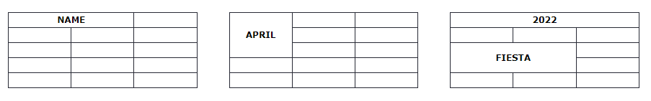
HTML Tables
HTML tables can have cells that spans over multiple rows and/or columns.

Slide 24
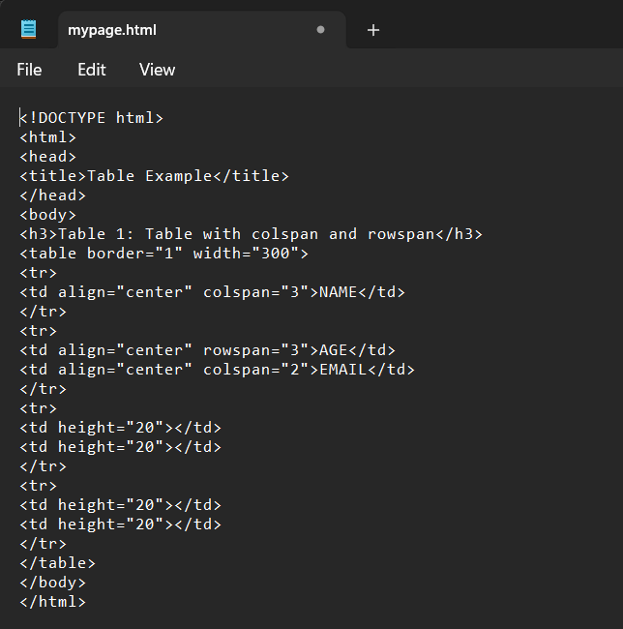
HTML Tables (Hands On)
rowspan and colspan

Slide 25
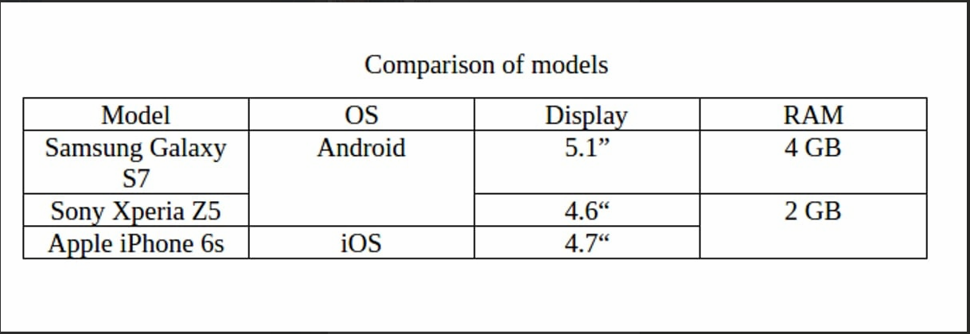
Exercise 1 : HTML Tables
Create the table below using the suitable tags and attributes

Slide 26
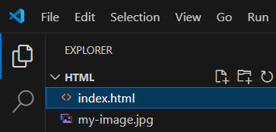
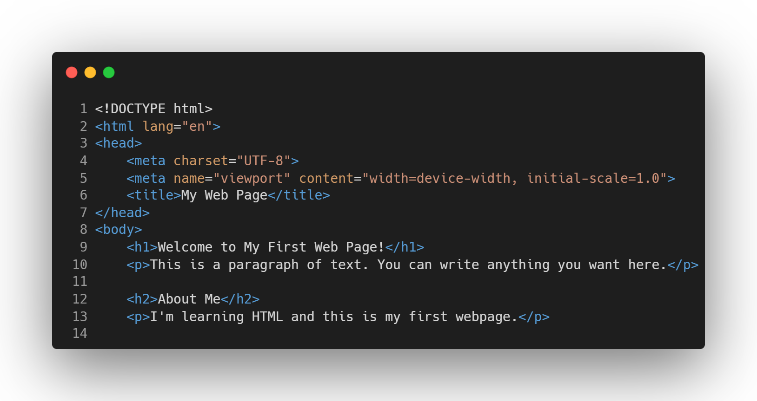
HTML in Visual Studio Code
(Hands On)
Create a file name “index.html”

Slide 27
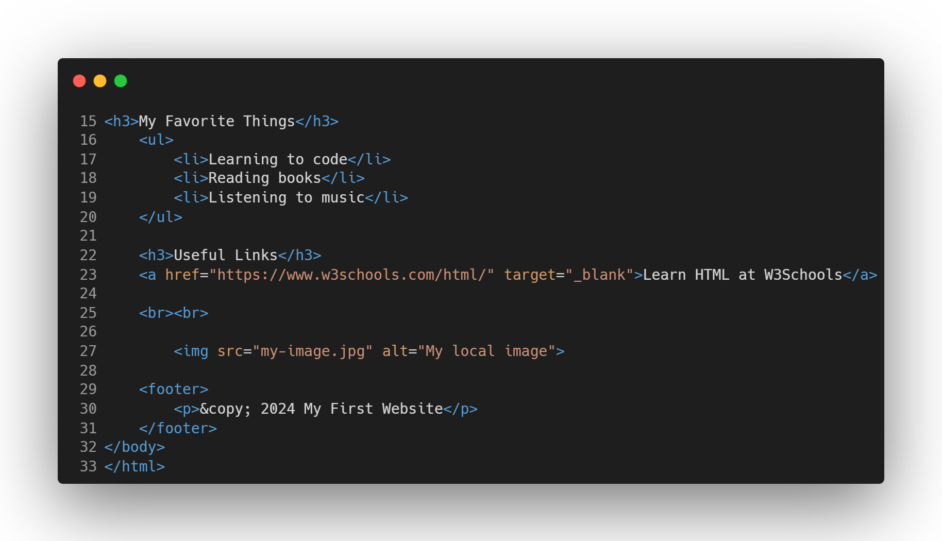
HTML in Visual Studio Code
(Hands On)
Create a file name “index.html”
Notes:
Essential HTML Document Structure:
<!DOCTYPE html>
<html lang="en">
<head>
<meta charset="UTF-8">
<meta name="viewport" content="width=device-width, initial-scale=1.0">
<title>Page Title</title>
</head>
<body>
<!-- Your content goes here -->
</body>
</html>
Explanation of Each Part:
<!DOCTYPE html>
Declares the document type and HTML version (HTML5)
<html>
Root element that contains all other elements
<head>
Contains metadata about the document (not visible on page)
<meta charset="UTF-8">
Specifies character encoding for the document
<meta name="viewport">
Controls how the page is displayed on mobile devices
<title>
Sets the title shown in browser tab
<body>
Contains all visible content of the webpage

Slide 28
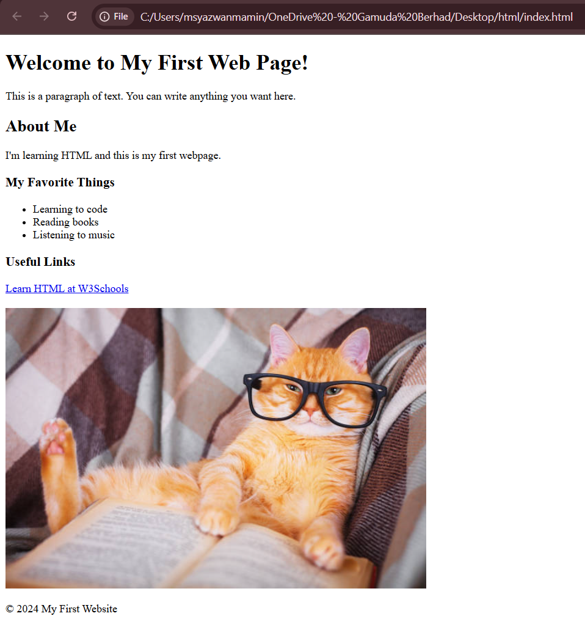
To open the file on browser:
Save this file as index.html in VS Code
Open it in your browser by double-clicking the file
Or use the Live Server extension in VS Code (to install)
You have just created
your first HTML webpage
Using VS Code!

